Slide 1
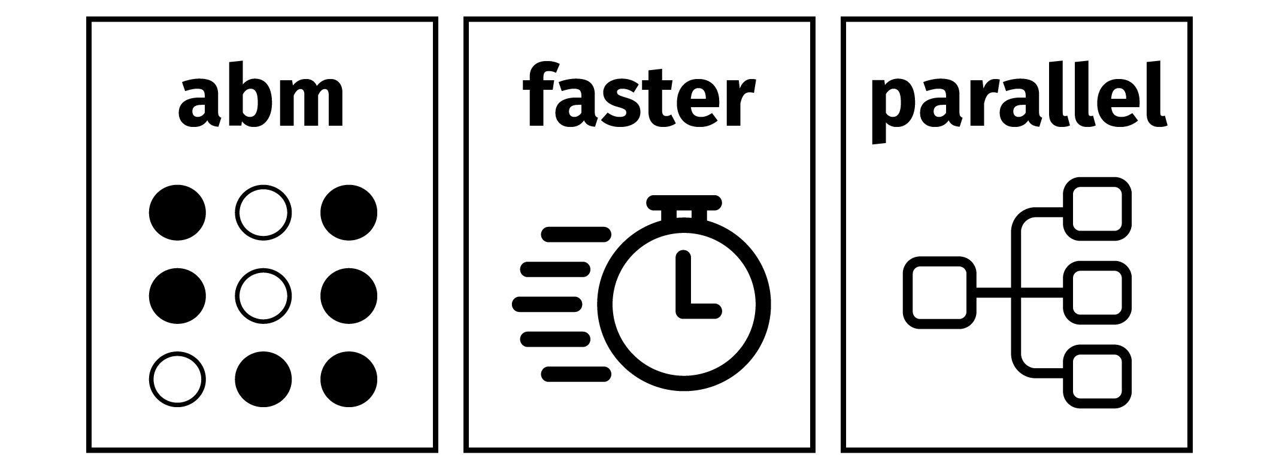
Hands-on 1 discussion

Slide 2
Supercomputing with R

Slide 3
Supercomputing structure
Create a parameter grid (data frame)
Create an analysis function that takes in a row of the parameter grid and outputs a result
Create a self-contained job script to load a chunk of the grid and run the analysis function on several rows in parallel
Create a shell script to run the R job with SLURM parameters

Slide 4
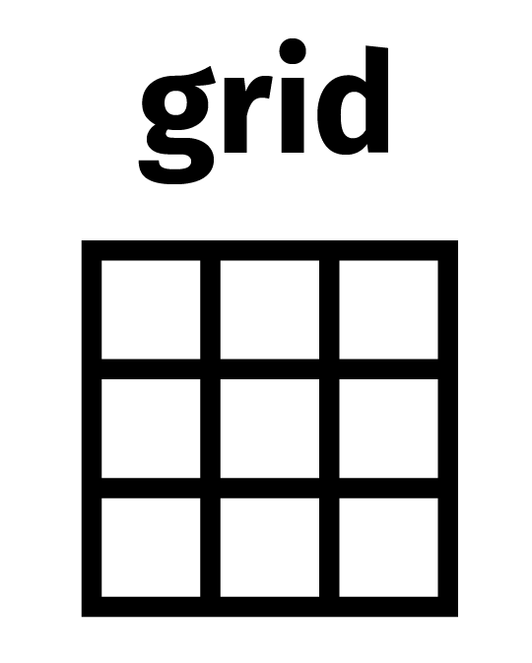

Slide 5
ABM for the Netherlands
We have a good ABM implementation now.
Let’s connect our ABM to real data
Base our proportion parameter on population data about neighbourhoods in NL
(fake, illustrative) research question:
What proportion of non-western migrants is “happy” with different levels of neighbourhood preference B_{a}?

Slide 6
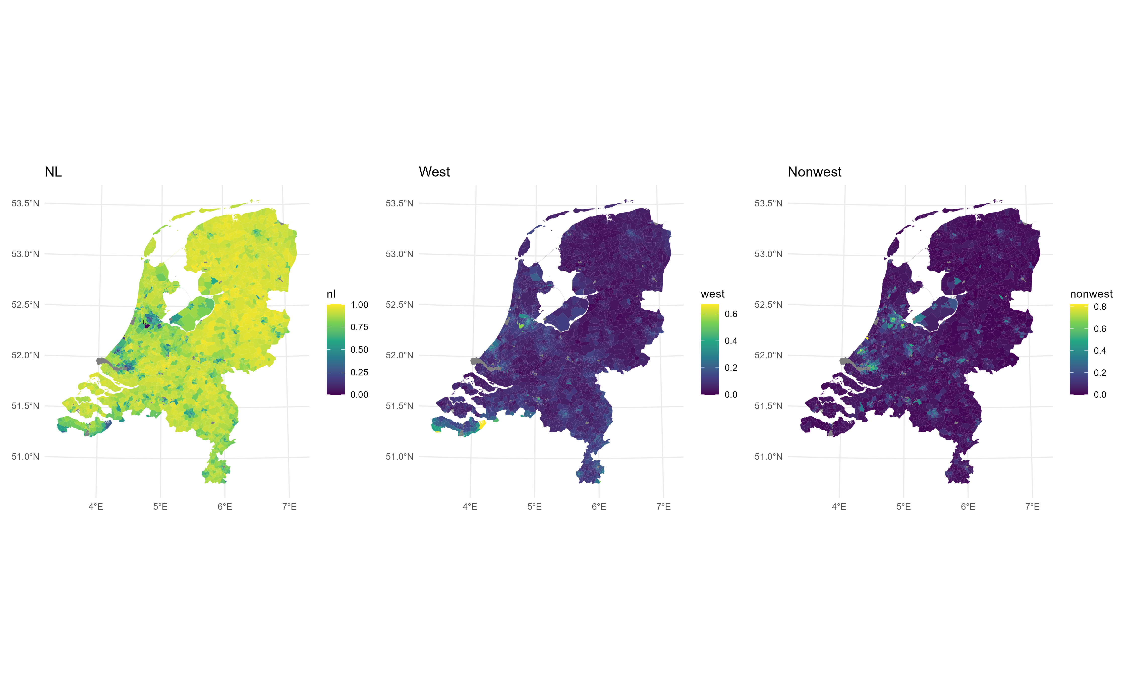
ABM for the Netherlands
https://www.pdok.nl/introductie/-/article/cbs-wijken-en-buurten

Slide 7
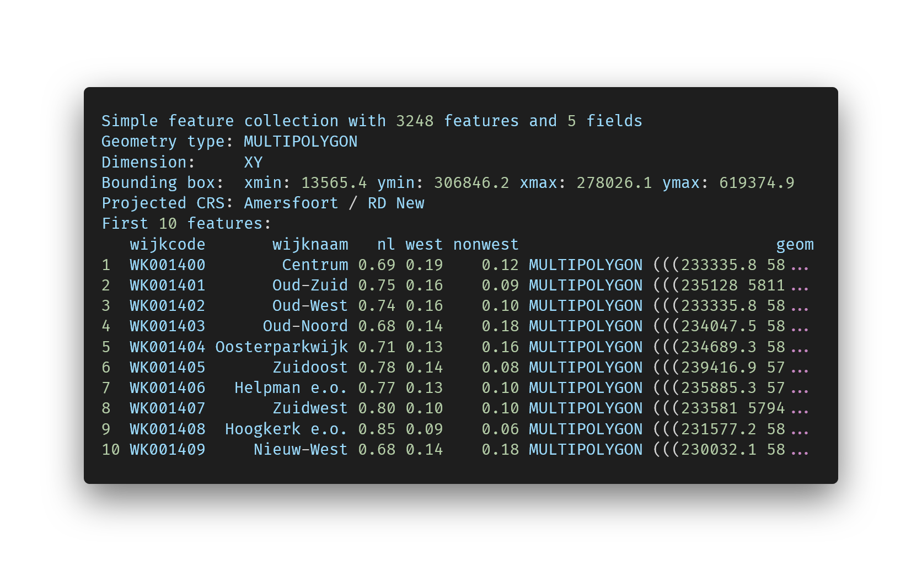
ABM for the Netherlands

Slide 8
Parameter grid
There are 3248 neighbourhoods in NL
We will inspect 91 different levels of Ba parameter
For stability, we want 50 iterations to average over
3248*91*50 = 14 778 400 ABMs to run!

Slide 9
Tibbles and nested columns
In the hands-on, you will go through the grid code
This is just 1 version / implementation
There are other ways to create the grid (probably faster, too)
End result: one row per desired result

Slide 10
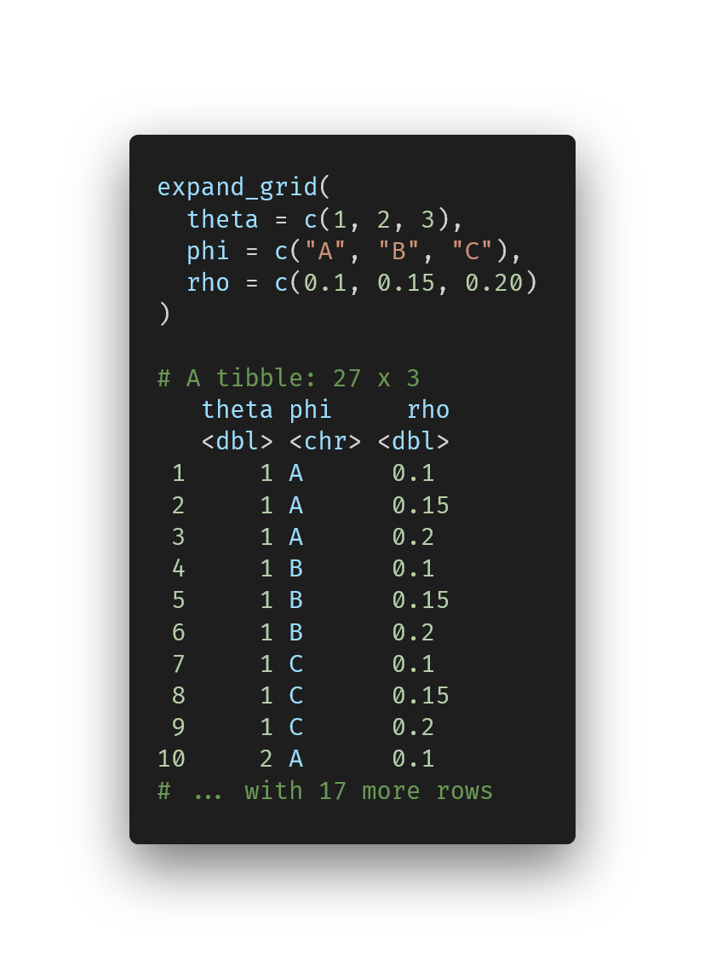
Tibbles and nested columns
Useful function: expand_grid()
Notes:
https://carbon.now.sh/?bg=rgba%28255%2C255%2C255%2C0%29&t=vscode&wt=none&l=r&width=680&ds=true&dsyoff=13px&dsblur=33px&wc=false&wa=true&pv=79px&ph=76px&ln=false&fl=1&fm=Fira+Code&fs=14px&lh=133%25&si=false&es=2x&wm=false&code=expand_grid%28%250A%2520%2520theta%2520%253D%2520c%281%252C%25202%252C%25203%29%252C%2520%250A%2520%2520phi%2520%253D%2520c%28%2522A%2522%252C%2520%2522B%2522%252C%2520%2522C%2522%29%252C%2520%250A%2520%2520rho%2520%253D%2520c%280.1%252C%25200.15%252C%25200.20%29%250A%29%250A%250A%2523%2520A%2520tibble%253A%252027%2520x%25203%250A%2520%2520%2520theta%2520phi%2520%2520%2520%2520%2520rho%250A%2520%2520%2520%253Cdbl%253E%2520%253Cchr%253E%2520%253Cdbl%253E%250A%25201%2520%2520%2520%2520%25201%2520A%2520%2520%2520%2520%2520%25200.1%2520%250A%25202%2520%2520%2520%2520%25201%2520A%2520%2520%2520%2520%2520%25200.15%250A%25203%2520%2520%2520%2520%25201%2520A%2520%2520%2520%2520%2520%25200.2%2520%250A%25204%2520%2520%2520%2520%25201%2520B%2520%2520%2520%2520%2520%25200.1%2520%250A%25205%2520%2520%2520%2520%25201%2520B%2520%2520%2520%2520%2520%25200.15%250A%25206%2520%2520%2520%2520%25201%2520B%2520%2520%2520%2520%2520%25200.2%2520%250A%25207%2520%2520%2520%2520%25201%2520C%2520%2520%2520%2520%2520%25200.1%2520%250A%25208%2520%2520%2520%2520%25201%2520C%2520%2520%2520%2520%2520%25200.15%250A%25209%2520%2520%2520%2520%25201%2520C%2520%2520%2520%2520%2520%25200.2%2520%250A10%2520%2520%2520%2520%25202%2520A%2520%2520%2520%2520%2520%25200.1%2520%250A%2523%2520...%2520with%252017%2520more%2520rows

Slide 11
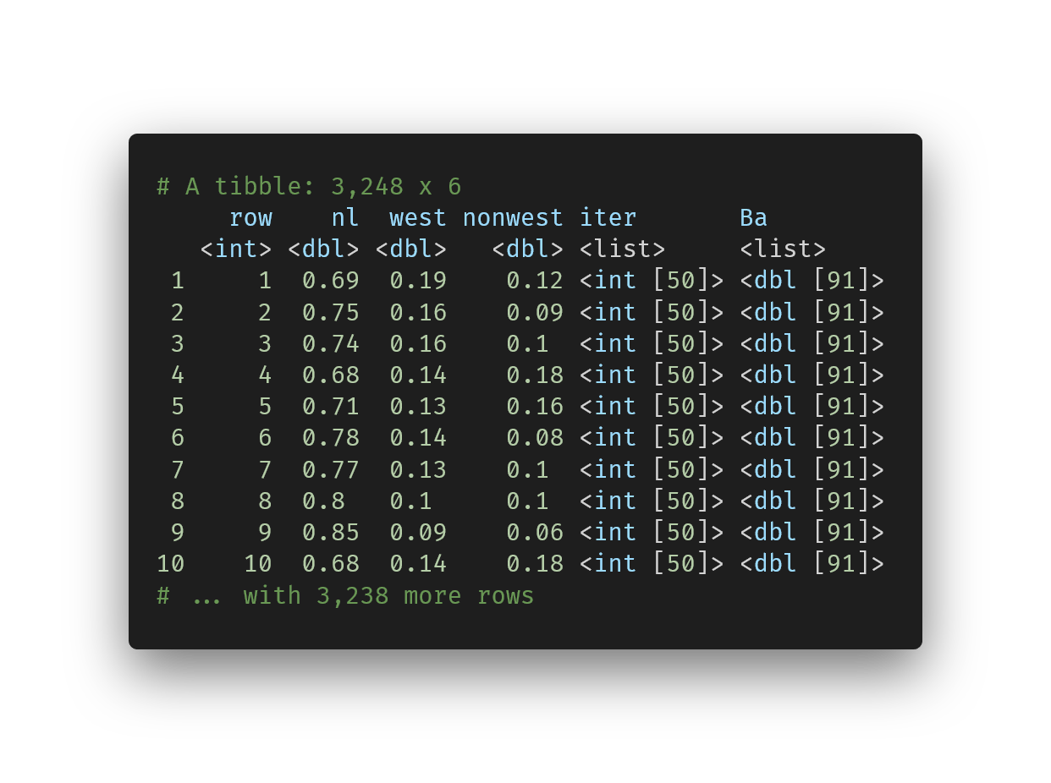
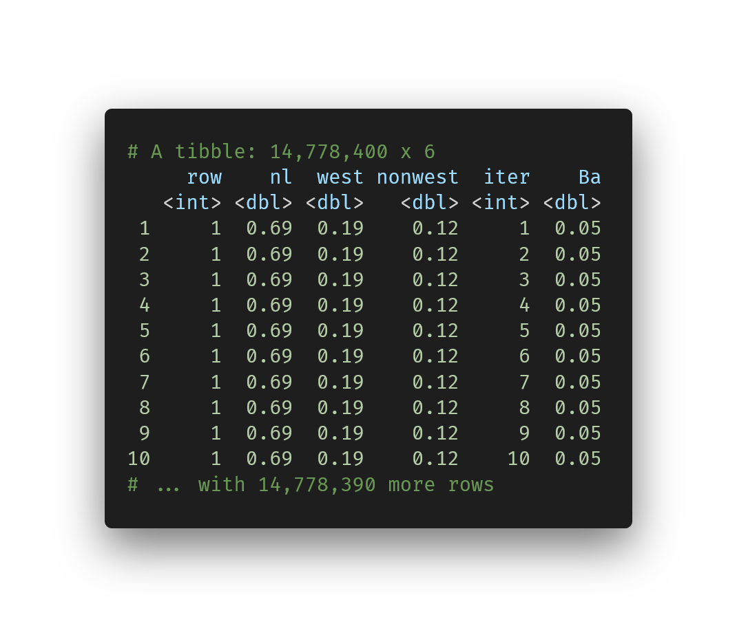
Tibbles and nested columns
We will use tibbles with nested columns
We unnest_longer() those nested columns to different rows:
Notes:
https://carbon.now.sh/?bg=rgba%28255%2C255%2C255%2C0%29&t=vscode&wt=none&l=r&width=680&ds=true&dsyoff=13px&dsblur=33px&wc=false&wa=true&pv=79px&ph=76px&ln=false&fl=1&fm=Fira+Code&fs=14px&lh=133%25&si=false&es=2x&wm=false&code=%2523%2520A%2520tibble%253A%25203%252C248%2520x%25206%250A%2520%2520%2520%2520%2520row%2520%2520%2520%2520nl%2520%2520west%2520nonwest%2520iter%2520%2520%2520%2520%2520%2520%2520Ba%2520%2520%2520%2520%2520%2520%2520%2520%250A%2520%2520%2520%253Cint%253E%2520%253Cdbl%253E%2520%253Cdbl%253E%2520%2520%2520%253Cdbl%253E%2520%253Clist%253E%2520%2520%2520%2520%2520%253Clist%253E%2520%2520%2520%2520%250A%25201%2520%2520%2520%2520%25201%2520%25200.69%2520%25200.19%2520%2520%2520%25200.12%2520%253Cint%2520%255B50%255D%253E%2520%253Cdbl%2520%255B91%255D%253E%250A%25202%2520%2520%2520%2520%25202%2520%25200.75%2520%25200.16%2520%2520%2520%25200.09%2520%253Cint%2520%255B50%255D%253E%2520%253Cdbl%2520%255B91%255D%253E%250A%25203%2520%2520%2520%2520%25203%2520%25200.74%2520%25200.16%2520%2520%2520%25200.1%2520%2520%253Cint%2520%255B50%255D%253E%2520%253Cdbl%2520%255B91%255D%253E%250A%25204%2520%2520%2520%2520%25204%2520%25200.68%2520%25200.14%2520%2520%2520%25200.18%2520%253Cint%2520%255B50%255D%253E%2520%253Cdbl%2520%255B91%255D%253E%250A%25205%2520%2520%2520%2520%25205%2520%25200.71%2520%25200.13%2520%2520%2520%25200.16%2520%253Cint%2520%255B50%255D%253E%2520%253Cdbl%2520%255B91%255D%253E%250A%25206%2520%2520%2520%2520%25206%2520%25200.78%2520%25200.14%2520%2520%2520%25200.08%2520%253Cint%2520%255B50%255D%253E%2520%253Cdbl%2520%255B91%255D%253E%250A%25207%2520%2520%2520%2520%25207%2520%25200.77%2520%25200.13%2520%2520%2520%25200.1%2520%2520%253Cint%2520%255B50%255D%253E%2520%253Cdbl%2520%255B91%255D%253E%250A%25208%2520%2520%2520%2520%25208%2520%25200.8%2520%2520%25200.1%2520%2520%2520%2520%25200.1%2520%2520%253Cint%2520%255B50%255D%253E%2520%253Cdbl%2520%255B91%255D%253E%250A%25209%2520%2520%2520%2520%25209%2520%25200.85%2520%25200.09%2520%2520%2520%25200.06%2520%253Cint%2520%255B50%255D%253E%2520%253Cdbl%2520%255B91%255D%253E%250A10%2520%2520%2520%252010%2520%25200.68%2520%25200.14%2520%2520%2520%25200.18%2520%253Cint%2520%255B50%255D%253E%2520%253Cdbl%2520%255B91%255D%253E%250A%2523%2520...%2520with%25203%252C238%2520more%2520rows
https://carbon.now.sh/?bg=rgba%28255%2C255%2C255%2C0%29&t=vscode&wt=none&l=r&width=680&ds=true&dsyoff=13px&dsblur=33px&wc=false&wa=true&pv=79px&ph=76px&ln=false&fl=1&fm=Fira+Code&fs=14px&lh=133%25&si=false&es=2x&wm=false&code=%2523%2520A%2520tibble%253A%252014%252C778%252C400%2520x%25206%250A%2520%2520%2520%2520%2520row%2520%2520%2520%2520nl%2520%2520west%2520nonwest%2520%2520iter%2520%2520%2520%2520Ba%250A%2520%2520%2520%253Cint%253E%2520%253Cdbl%253E%2520%253Cdbl%253E%2520%2520%2520%253Cdbl%253E%2520%253Cint%253E%2520%253Cdbl%253E%250A%25201%2520%2520%2520%2520%25201%2520%25200.69%2520%25200.19%2520%2520%2520%25200.12%2520%2520%2520%2520%25201%2520%25200.05%250A%25202%2520%2520%2520%2520%25201%2520%25200.69%2520%25200.19%2520%2520%2520%25200.12%2520%2520%2520%2520%25202%2520%25200.05%250A%25203%2520%2520%2520%2520%25201%2520%25200.69%2520%25200.19%2520%2520%2520%25200.12%2520%2520%2520%2520%25203%2520%25200.05%250A%25204%2520%2520%2520%2520%25201%2520%25200.69%2520%25200.19%2520%2520%2520%25200.12%2520%2520%2520%2520%25204%2520%25200.05%250A%25205%2520%2520%2520%2520%25201%2520%25200.69%2520%25200.19%2520%2520%2520%25200.12%2520%2520%2520%2520%25205%2520%25200.05%250A%25206%2520%2520%2520%2520%25201%2520%25200.69%2520%25200.19%2520%2520%2520%25200.12%2520%2520%2520%2520%25206%2520%25200.05%250A%25207%2520%2520%2520%2520%25201%2520%25200.69%2520%25200.19%2520%2520%2520%25200.12%2520%2520%2520%2520%25207%2520%25200.05%250A%25208%2520%2520%2520%2520%25201%2520%25200.69%2520%25200.19%2520%2520%2520%25200.12%2520%2520%2520%2520%25208%2520%25200.05%250A%25209%2520%2520%2520%2520%25201%2520%25200.69%2520%25200.19%2520%2520%2520%25200.12%2520%2520%2520%2520%25209%2520%25200.05%250A10%2520%2520%2520%2520%25201%2520%25200.69%2520%25200.19%2520%2520%2520%25200.12%2520%2520%2520%252010%2520%25200.05%250A%2523%2520...%2520with%252014%252C778%252C390%2520more%2520rows

Slide 12
More of this in the hands-on later

Slide 13
Supercomputing structure
Create a parameter grid (data frame)
Create an analysis function that takes in a row of the parameter grid and outputs a result
Create a self-contained job script to load a chunk of the grid and run the analysis function on several rows in parallel
Create a shell script to run the R job with SLURM parameters

Slide 14


Slide 15
The analysis function
What it does
Input a row from the grid
Output our quantity of interest (proportion of happy nonwestern migrants)
Should be robust, i.e., deal with problematic inputs gracefully
You should spend time testing this, you will literally run this code a million times

Slide 16
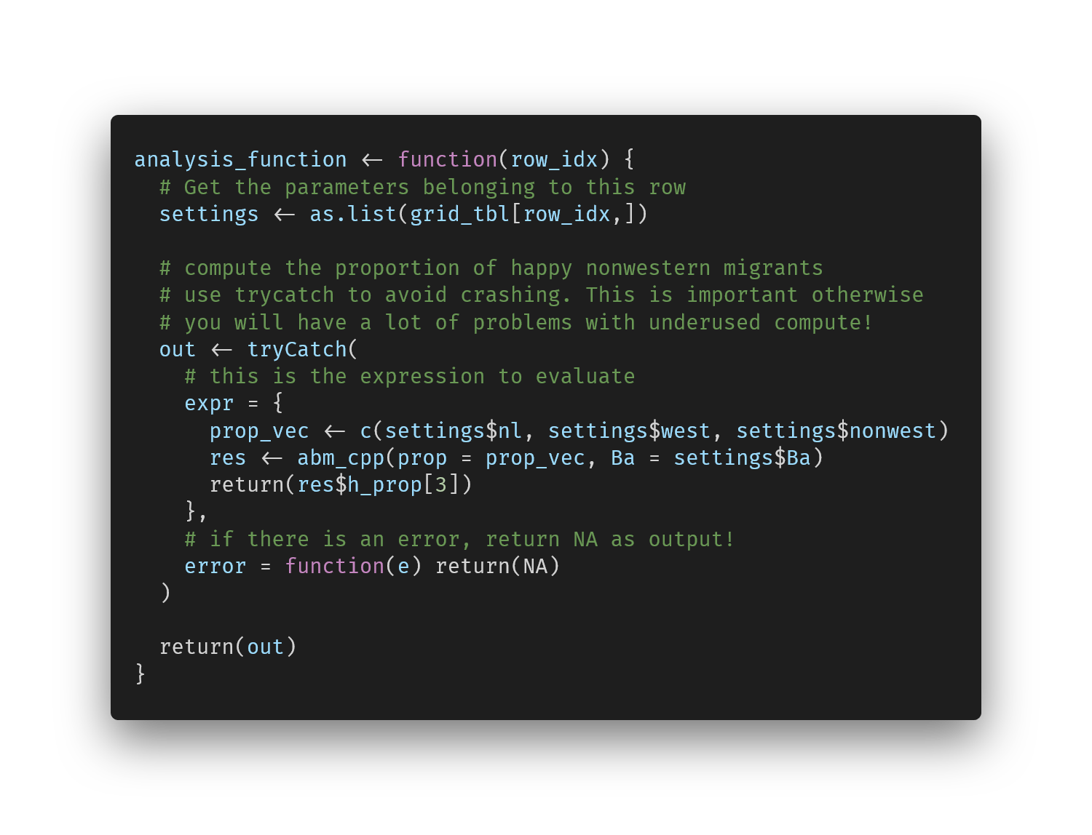
The analysis function
Notes:
https://carbon.now.sh/?bg=rgba%28255%2C255%2C255%2C0%29&t=vscode&wt=none&l=r&width=680&ds=true&dsyoff=13px&dsblur=33px&wc=false&wa=true&pv=79px&ph=76px&ln=false&fl=1&fm=Fira+Code&fs=14px&lh=133%25&si=false&es=2x&wm=false&code=analysis_function%2520%253C-%2520function%28row_idx%29%2520%257B%250A%2520%2520%2523%2520Get%2520the%2520parameters%2520belonging%2520to%2520this%2520row%250A%2520%2520settings%2520%253C-%2520as.list%28grid_tbl%255Brow_idx%252C%255D%29%250A%2520%2520%250A%2520%2520%2523%2520compute%2520the%2520proportion%2520of%2520happy%2520nonwestern%2520migrants%250A%2520%2520%2523%2520use%2520trycatch%2520to%2520avoid%2520crashing.%2520This%2520is%2520important%2520otherwise%250A%2520%2520%2523%2520you%2520will%2520have%2520a%2520lot%2520of%2520problems%2520with%2520underused%2520compute%21%250A%2520%2520out%2520%253C-%2520tryCatch%28%250A%2520%2520%2520%2520%2523%2520this%2520is%2520the%2520expression%2520to%2520evaluate%250A%2520%2520%2520%2520expr%2520%253D%2520%257B%250A%2520%2520%2520%2520%2520%2520prop_vec%2520%253C-%2520c%28settings%2524nl%252C%2520settings%2524west%252C%2520settings%2524nonwest%29%250A%2520%2520%2520%2520%2520%2520res%2520%253C-%2520abm_cpp%28prop%2520%253D%2520prop_vec%252C%2520Ba%2520%253D%2520settings%2524Ba%29%250A%2520%2520%2520%2520%2520%2520return%28res%2524h_prop%255B3%255D%29%250A%2520%2520%2520%2520%257D%252C%2520%250A%2520%2520%2520%2520%2523%2520if%2520there%2520is%2520an%2520error%252C%2520return%2520NA%2520as%2520output%21%250A%2520%2520%2520%2520error%2520%253D%2520function%28e%29%2520return%28NA%29%250A%2520%2520%29%250A%2520%2520%250A%2520%2520return%28out%29%250A%257D

Slide 17
The R job script
What it does
Input a job number
Output a file with results from the ABMs and a log file
Self-contained, runnable from the command-line
Nice logging capabilities to show where things are going wrong if they do
Within-node parallellization(!)

Slide 18
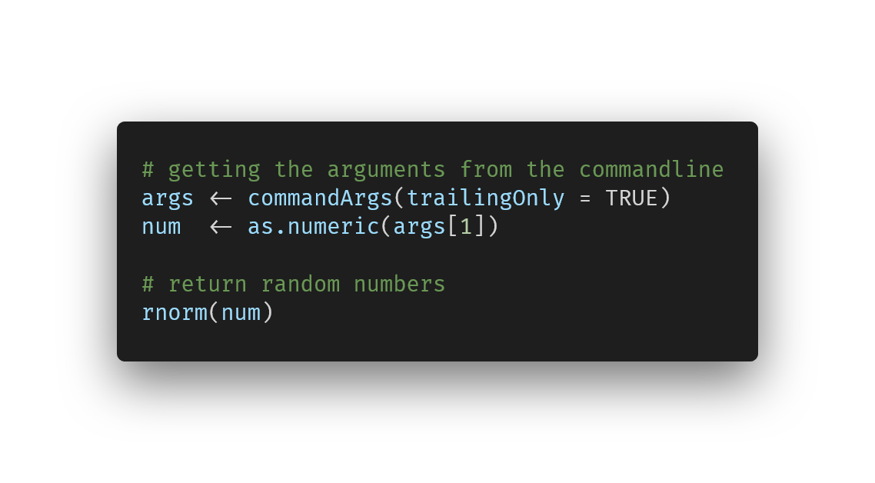
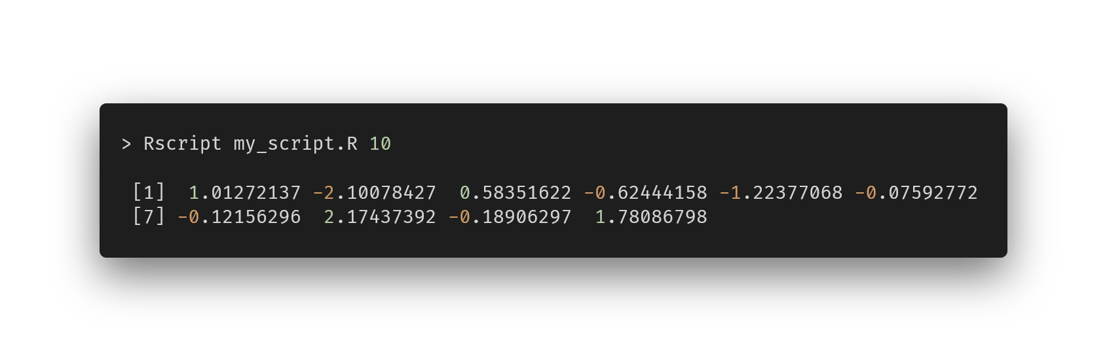
Self-contained R scripts
You can run R in non-interactive mode (if it’s in your environment variables)
Notes:
https://carbon.now.sh/?bg=rgba%28255%2C255%2C255%2C0%29&t=vscode&wt=none&l=r&width=680&ds=true&dsyoff=13px&dsblur=33px&wc=false&wa=true&pv=79px&ph=76px&ln=false&fl=1&fm=Fira+Code&fs=14px&lh=133%25&si=false&es=2x&wm=false&code=%2523%2520getting%2520the%2520arguments%2520from%2520the%2520commandline%250Aargs%2520%253C-%2520commandArgs%28trailingOnly%2520%253D%2520TRUE%29%250Anum%2520%2520%253C-%2520as.numeric%28args%255B1%255D%29%250A%250A%2523%2520return%2520random%2520numbers%250Arnorm%28num%29
https://carbon.now.sh/?bg=rgba%28255%2C255%2C255%2C0%29&t=vscode&wt=none&l=application%2Fx-sh&width=680&ds=true&dsyoff=13px&dsblur=33px&wc=false&wa=true&pv=79px&ph=76px&ln=false&fl=1&fm=Fira+Code&fs=14px&lh=133%25&si=false&es=2x&wm=false&code=%253E%2520Rscript%2520my_script.R%252010%250A%250A%2520%255B1%255D%2520%25201.01272137%2520-2.10078427%2520%25200.58351622%2520-0.62444158%2520-1.22377068%2520-0.07592772%250A%2520%255B7%255D%2520-0.12156296%2520%25202.17437392%2520-0.18906297%2520%25201.78086798

Slide 19
Logging
There are several options available, e.g., the package logging
For our case, we only need simple print (cat()) statements
SLURM will store the R console output to a file
Include statements in the script about which step is running
Include timestamps / elapsed time
Notes:
https://carbon.now.sh/?bg=rgba%28255%2C255%2C255%2C0%29&t=vscode&wt=none&l=r&width=680&ds=true&dsyoff=13px&dsblur=33px&wc=false&wa=true&pv=79px&ph=76px&ln=false&fl=1&fm=Fira+Code&fs=14px&lh=133%25&si=false&es=2x&wm=false&code=%2523%2520getting%2520the%2520arguments%2520from%2520the%2520commandline%250Aargs%2520%253C-%2520commandArgs%28trailingOnly%2520%253D%2520TRUE%29%250Anum%2520%2520%253C-%2520as.numeric%28args%255B1%255D%29%250A%250A%2523%2520return%2520random%2520numbers%250Arnorm%28num%29
https://carbon.now.sh/?bg=rgba%28255%2C255%2C255%2C0%29&t=vscode&wt=none&l=application%2Fx-sh&width=680&ds=true&dsyoff=13px&dsblur=33px&wc=false&wa=true&pv=79px&ph=76px&ln=false&fl=1&fm=Fira+Code&fs=14px&lh=133%25&si=false&es=2x&wm=false&code=%253E%2520Rscript%2520my_script.R%252010%250A%250A%2520%255B1%255D%2520%25201.01272137%2520-2.10078427%2520%25200.58351622%2520-0.62444158%2520-1.22377068%2520-0.07592772%250A%2520%255B7%255D%2520-0.12156296%2520%25202.17437392%2520-0.18906297%2520%25201.78086798

Slide 20
Within-node parallellization
In SLURM, you get (and pay for!) an entire node at a time
Therefore, your R scripts need within-node parallellization
Compute results for multiple grid rows at a time
“Chunking” your grid
Notes:
https://carbon.now.sh/?bg=rgba%28255%2C255%2C255%2C0%29&t=vscode&wt=none&l=r&width=680&ds=true&dsyoff=13px&dsblur=33px&wc=false&wa=true&pv=79px&ph=76px&ln=false&fl=1&fm=Fira+Code&fs=14px&lh=133%25&si=false&es=2x&wm=false&code=%2523%2520getting%2520the%2520arguments%2520from%2520the%2520commandline%250Aargs%2520%253C-%2520commandArgs%28trailingOnly%2520%253D%2520TRUE%29%250Anum%2520%2520%253C-%2520as.numeric%28args%255B1%255D%29%250A%250A%2523%2520return%2520random%2520numbers%250Arnorm%28num%29
https://carbon.now.sh/?bg=rgba%28255%2C255%2C255%2C0%29&t=vscode&wt=none&l=application%2Fx-sh&width=680&ds=true&dsyoff=13px&dsblur=33px&wc=false&wa=true&pv=79px&ph=76px&ln=false&fl=1&fm=Fira+Code&fs=14px&lh=133%25&si=false&es=2x&wm=false&code=%253E%2520Rscript%2520my_script.R%252010%250A%250A%2520%255B1%255D%2520%25201.01272137%2520-2.10078427%2520%25200.58351622%2520-0.62444158%2520-1.22377068%2520-0.07592772%250A%2520%255B7%255D%2520-0.12156296%2520%25202.17437392%2520-0.18906297%2520%25201.78086798

Slide 21
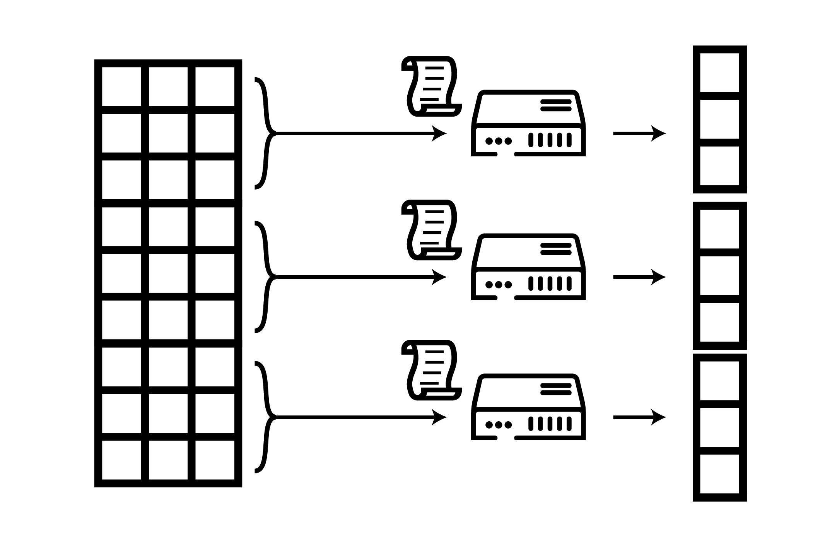

Slide 22
Within-node parallellization
Get chunk
Start cluster / child processes
Compute chunk results on cluster
Save output to file (results_001.rds)
Notes:
https://carbon.now.sh/?bg=rgba%28255%2C255%2C255%2C0%29&t=vscode&wt=none&l=r&width=680&ds=true&dsyoff=13px&dsblur=33px&wc=false&wa=true&pv=79px&ph=76px&ln=false&fl=1&fm=Fira+Code&fs=14px&lh=133%25&si=false&es=2x&wm=false&code=%2523%2520getting%2520the%2520arguments%2520from%2520the%2520commandline%250Aargs%2520%253C-%2520commandArgs%28trailingOnly%2520%253D%2520TRUE%29%250Anum%2520%2520%253C-%2520as.numeric%28args%255B1%255D%29%250A%250A%2523%2520return%2520random%2520numbers%250Arnorm%28num%29
https://carbon.now.sh/?bg=rgba%28255%2C255%2C255%2C0%29&t=vscode&wt=none&l=application%2Fx-sh&width=680&ds=true&dsyoff=13px&dsblur=33px&wc=false&wa=true&pv=79px&ph=76px&ln=false&fl=1&fm=Fira+Code&fs=14px&lh=133%25&si=false&es=2x&wm=false&code=%253E%2520Rscript%2520my_script.R%252010%250A%250A%2520%255B1%255D%2520%25201.01272137%2520-2.10078427%2520%25200.58351622%2520-0.62444158%2520-1.22377068%2520-0.07592772%250A%2520%255B7%255D%2520-0.12156296%2520%25202.17437392%2520-0.18906297%2520%25201.78086798

Slide 23
Within-node parallellization
How big should the chunk be?
Depends on
speed (ABM runs/second/core)
number of cores on the node (16)
how long you want each job to take
How long? Make it manageable, e.g., 30 minutes
If something goes wrong (and something will go wrong!) you can rerun in reasonable amount of time
Balance manageability and overhead: data loading, Rcpp code compiling, results storing
Notes:
https://carbon.now.sh/?bg=rgba%28255%2C255%2C255%2C0%29&t=vscode&wt=none&l=r&width=680&ds=true&dsyoff=13px&dsblur=33px&wc=false&wa=true&pv=79px&ph=76px&ln=false&fl=1&fm=Fira+Code&fs=14px&lh=133%25&si=false&es=2x&wm=false&code=%2523%2520getting%2520the%2520arguments%2520from%2520the%2520commandline%250Aargs%2520%253C-%2520commandArgs%28trailingOnly%2520%253D%2520TRUE%29%250Anum%2520%2520%253C-%2520as.numeric%28args%255B1%255D%29%250A%250A%2523%2520return%2520random%2520numbers%250Arnorm%28num%29
https://carbon.now.sh/?bg=rgba%28255%2C255%2C255%2C0%29&t=vscode&wt=none&l=application%2Fx-sh&width=680&ds=true&dsyoff=13px&dsblur=33px&wc=false&wa=true&pv=79px&ph=76px&ln=false&fl=1&fm=Fira+Code&fs=14px&lh=133%25&si=false&es=2x&wm=false&code=%253E%2520Rscript%2520my_script.R%252010%250A%250A%2520%255B1%255D%2520%25201.01272137%2520-2.10078427%2520%25200.58351622%2520-0.62444158%2520-1.22377068%2520-0.07592772%250A%2520%255B7%255D%2520-0.12156296%2520%25202.17437392%2520-0.18906297%2520%25201.78086798

Slide 24
More of this in the hands-on later

Slide 25
Supercomputing structure
Create a parameter grid (data frame)
Create an analysis function that takes in a row of the parameter grid and outputs a result
Create a self-contained job script to load a chunk of the grid and run the analysis function on several rows in parallel
Create a shell script to run the R job with SLURM parameters

Slide 26


Slide 27
Shell script
We will use array jobs (as per SLURM terminology)
sbatch –a 1-77 my_script.sh
Will queue 77 jobs
Each job has a different environment variable SLURM_ARRAY_TASK_ID
Pass this environment variable to Rscript

Slide 28
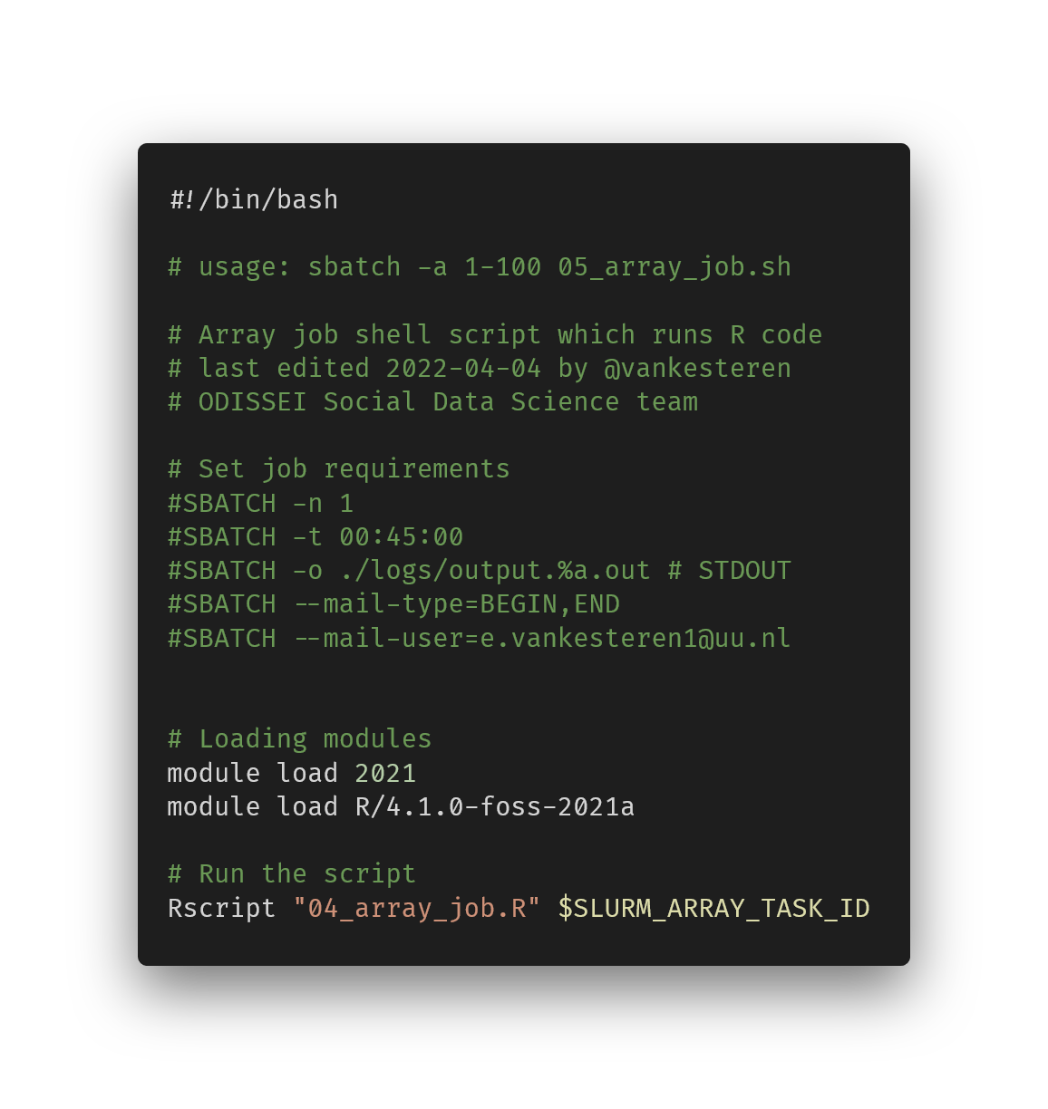
Shell script
Notes:
https://carbon.now.sh/?bg=rgba%28255%2C255%2C255%2C0%29&t=vscode&wt=none&l=application%2Fx-sh&width=680&ds=true&dsyoff=13px&dsblur=33px&wc=false&wa=true&pv=79px&ph=76px&ln=false&fl=1&fm=Fira+Code&fs=14px&lh=133%25&si=false&es=2x&wm=false&code=%2523%21%252Fbin%252Fbash%250A%250A%2523%2520usage%253A%2520sbatch%2520-a%25201-100%252005_array_job.sh%250A%250A%2523%2520Array%2520job%2520shell%2520script%2520which%2520runs%2520R%2520code%250A%2523%2520last%2520edited%25202022-04-04%2520by%2520%2540vankesteren%250A%2523%2520ODISSEI%2520Social%2520Data%2520Science%2520team%250A%250A%2523%2520Set%2520job%2520requirements%250A%2523SBATCH%2520-n%25201%250A%2523SBATCH%2520-t%252000%253A45%253A00%250A%2523SBATCH%2520-o%2520.%252Flogs%252Foutput.%2525a.out%2520%2523%2520STDOUT%250A%2523SBATCH%2520--mail-type%253DBEGIN%252CEND%250A%2523SBATCH%2520--mail-user%253De.vankesteren1%2540uu.nl%250A%250A%250A%2523%2520Loading%2520modules%250Amodule%2520load%25202021%250Amodule%2520load%2520R%252F4.1.0-foss-2021a%250A%250A%2523%2520Run%2520the%2520script%250ARscript%2520%252204_array_job.R%2522%2520%2524SLURM_ARRAY_TASK_ID

Slide 29
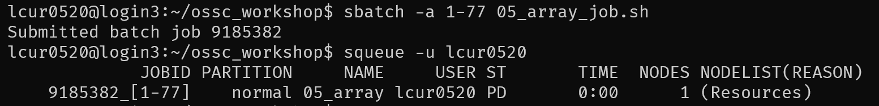
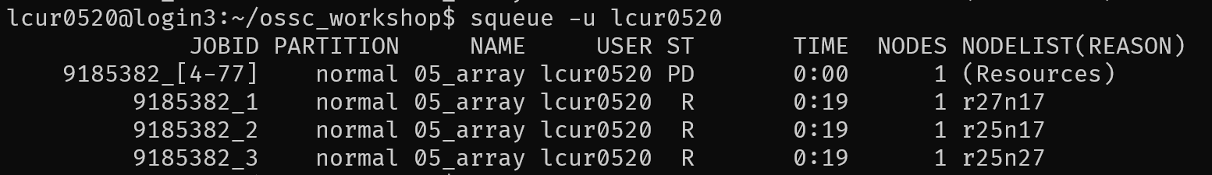
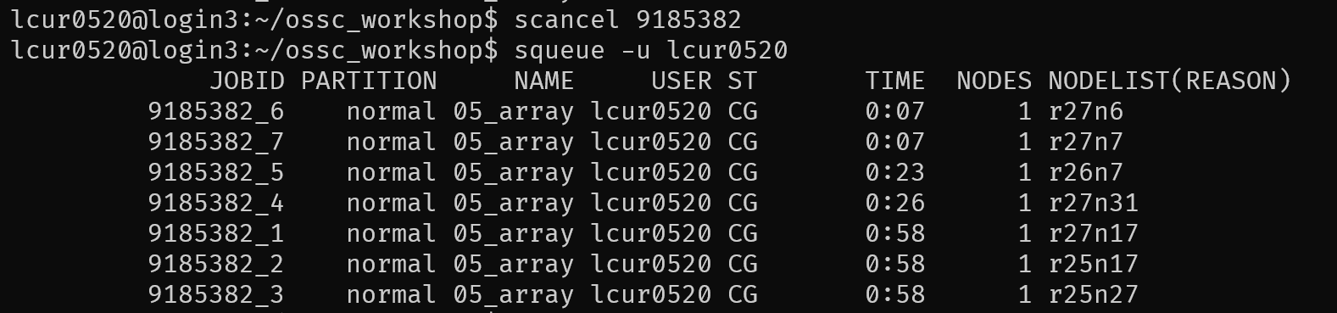

Slide 30
Supercomputing structure
Create a parameter grid (data frame)
Create an analysis function that takes in a row of the parameter grid and outputs a result
Create a self-contained job script to load a chunk of the grid and run the analysis function on several rows in parallel
Create a shell script to run the R job with SLURM parameters

Slide 31
Hands-on session 2

Slide 32
Questions?

Slide 33
Default light slide
Default subheading
This is the body of the text
Default subheading
Note that the text is not black, but “black, text 1, lighter 25%”
Default subheading
This makes things easier on the eyes
Default subheading
This is the body of the text

Slide 34
Default dark slide
Default subheading
The dark slide brings some variation
Default subheading
It can highlight important aspects of the presentation.
Default subheading
This is the body of the text
Default subheading
This is the body of the text

Slide 35
Is this an impact slide?

Slide 36
Here is an impactful slide with a sentence on it.
Here is a topic related to the aforementioned question.

